Slide 1


2021
CS-5542 Project Presentation
Cow Face Recognition System
Group 19: Kent Xu
Huanwei Zhang

Slide 2
contents
01
02
03
04
Idea
Significance
Objectives
Detail of the project

Slide 3
01
The motivation behind the idea
part 2
part 1
Our final project is a cow face recognition system ,This system can recognize cows by taking photos or manually inputting pictures.Because this system can actually help farmers to manage their cows in the real world. Compared with the many movie rating predictions that already exist now, we think we have a better application value to make a cow face recognition system.
At first, our project idea was to make a prediction of movie ratings and box office based on reviews.But after an ICP on image recognition and classification, we decided to change the topic of our project.

Slide 4
02
Significance:
For example, when the farm needs to vaccinate cows, the traditional method requires manual marking on the ears of the cow. The cow face recognition system can directly mark the cow's number in the system. When the cow face is recognized again next time, the vaccination information can be obtained from the system.
For real-world applications, using our system can effectively identify cows by directly taking pictures
Our data is from 66 cows on a real farm. In actual use,using this system will be more efficient.

Slide 5
Use the trained model to recognize the cow face
Import necessary libraries and configure some parameters. upload the picture, convert it to gray, use the classifier(cv2) to find out the range of the face area and the record them
Objectives:
03
Define and train the model
Save the result and visualize the outcome
Use the trained model to recognize the cow face
SVM VS. CNN (We tried another way to recognize the cow face. We use SVM to do a prediction. But we found it very inaccurate to do classification. Anyway, we can make a contrast between CNN and SVM.)

Slide 6
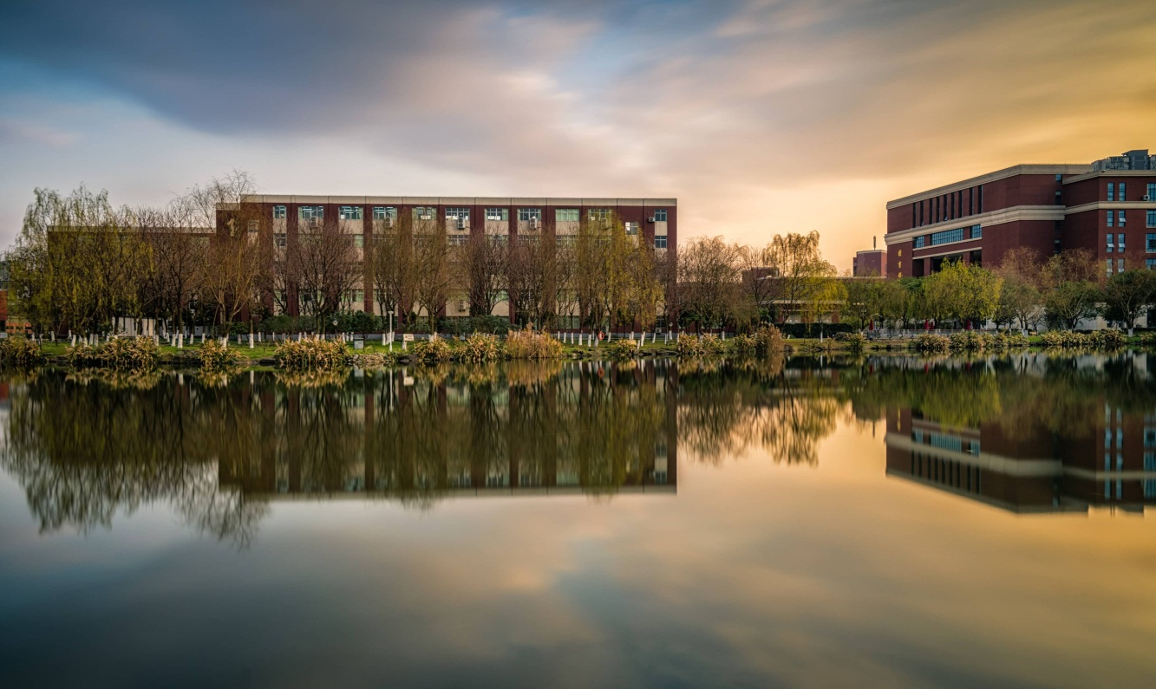
Features
1.The training data of our system is all collected from 66 cows on a real farm, not from a certain dataset in the internet, so it is very useful.
2. Our system can input data directly by taking photos, or upload photos manually.
3.The output result is a model，use this model for cow face recognition

Slide 7

04
Detail of the project
01
PART
dataset

Slide 8
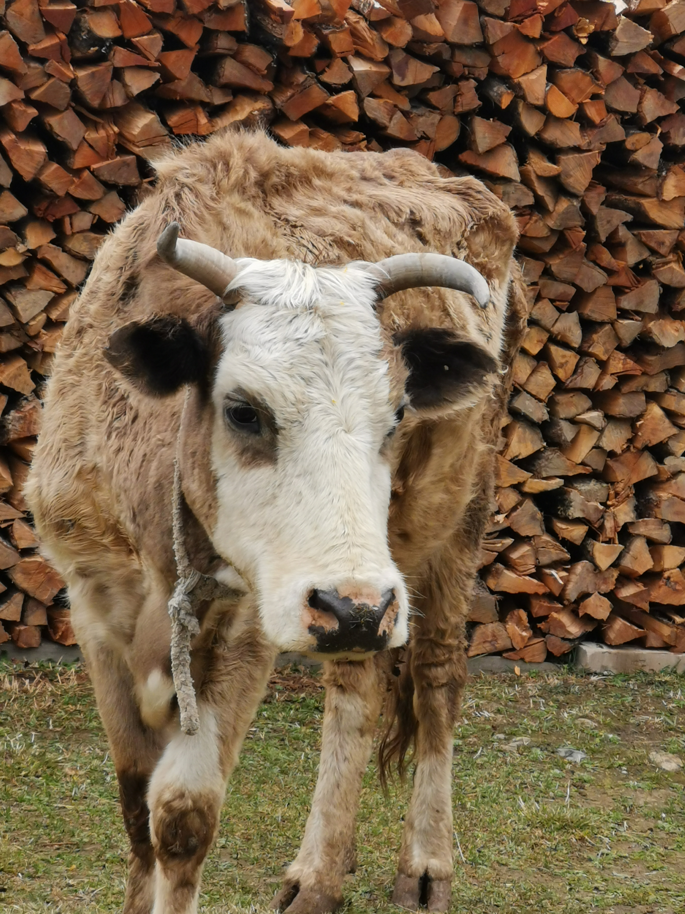
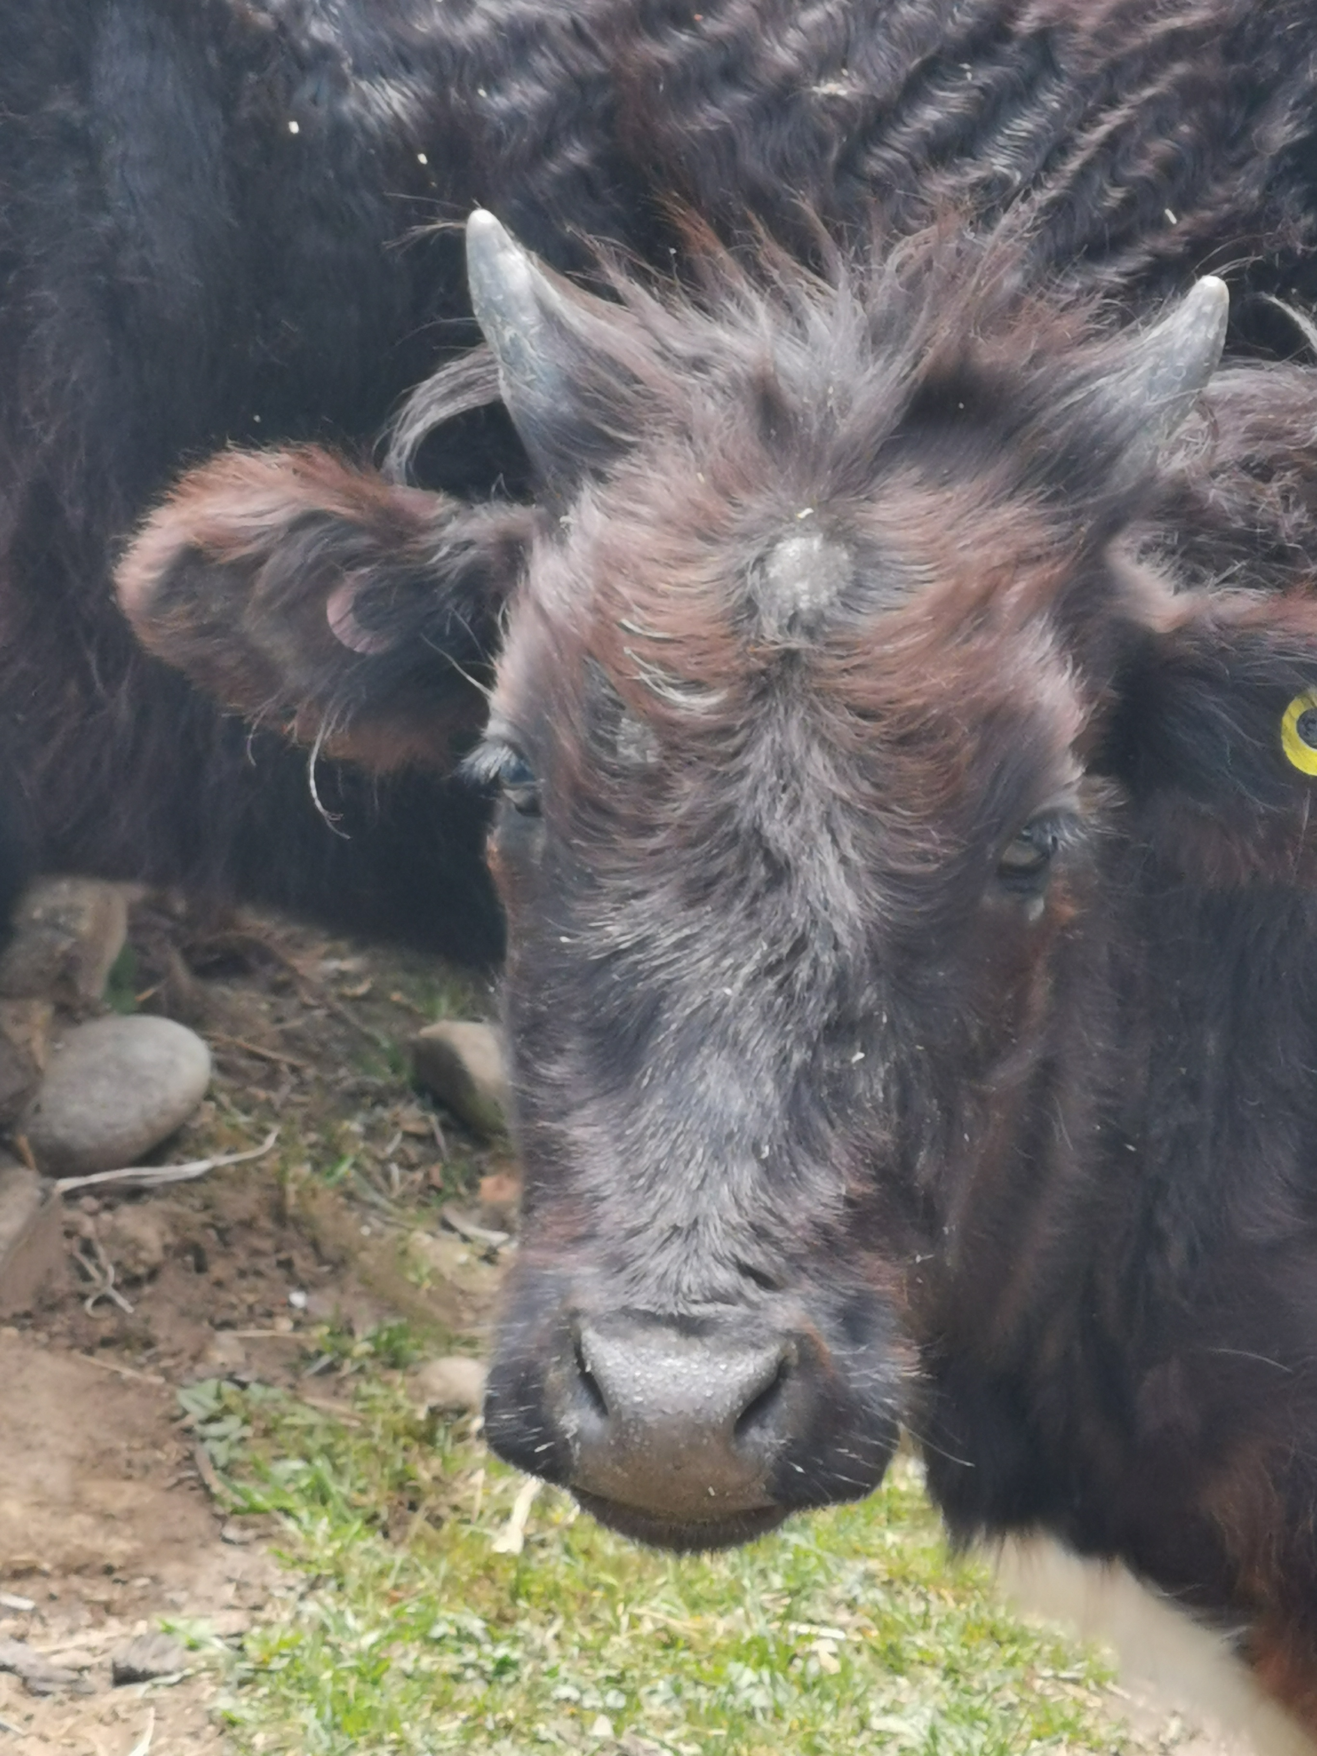
Dataset
The data are pictures of 66 cows. Here are some examples.
Cow No.1
Cow No.9

Slide 9
02
PART
model

Slide 10
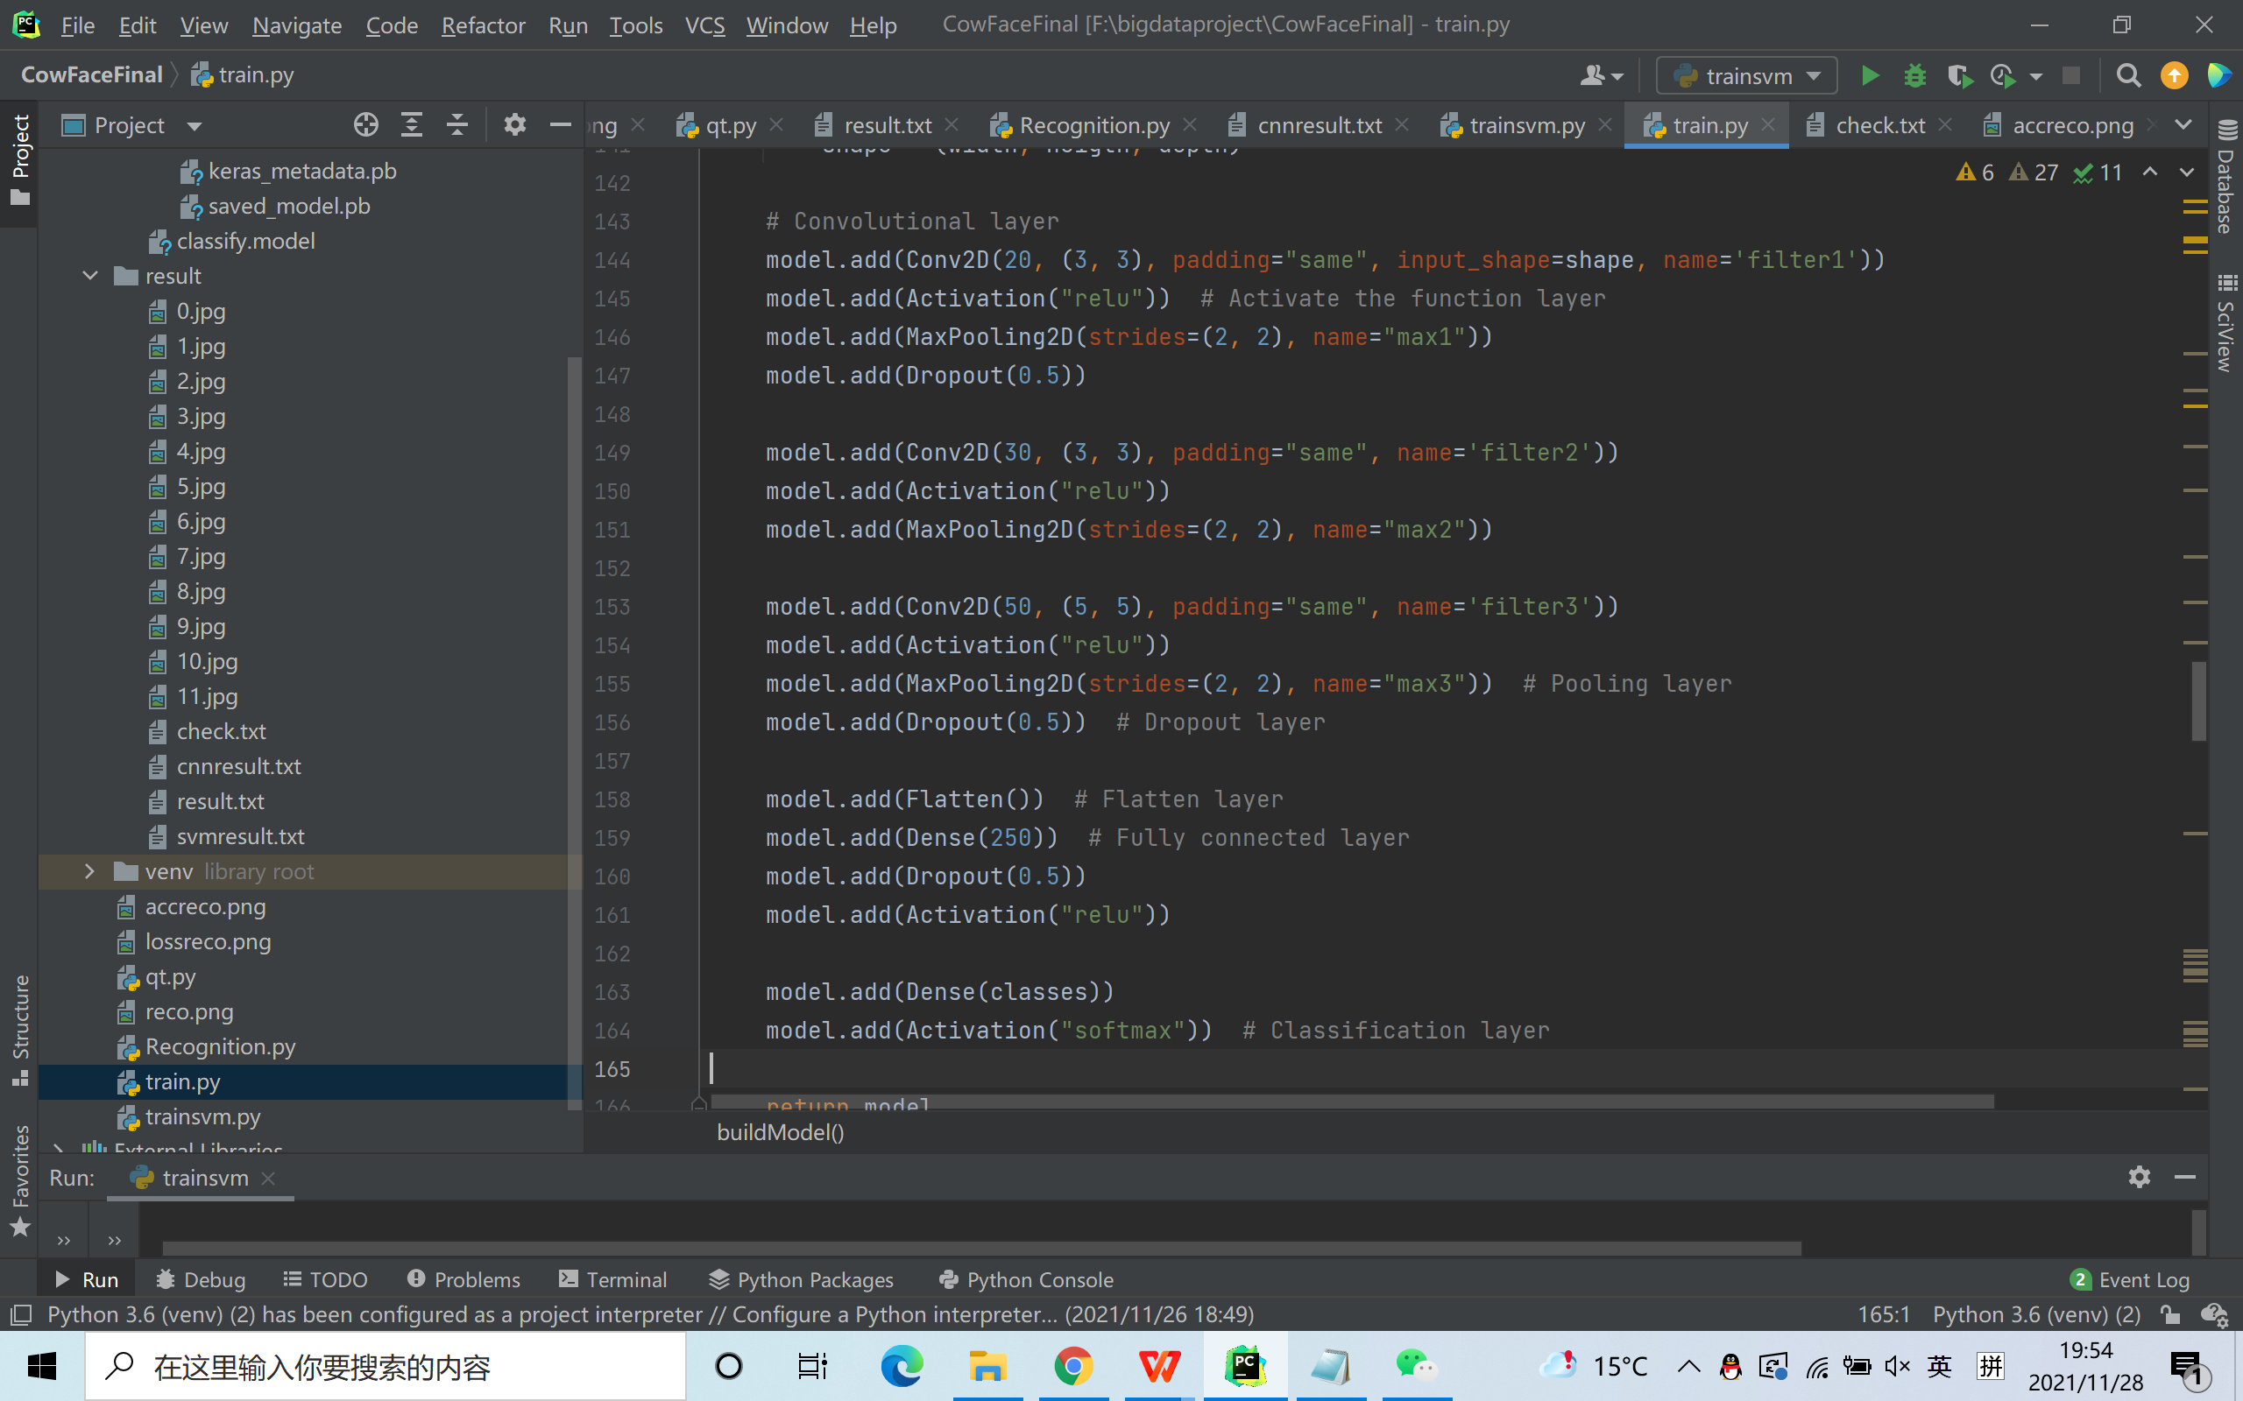
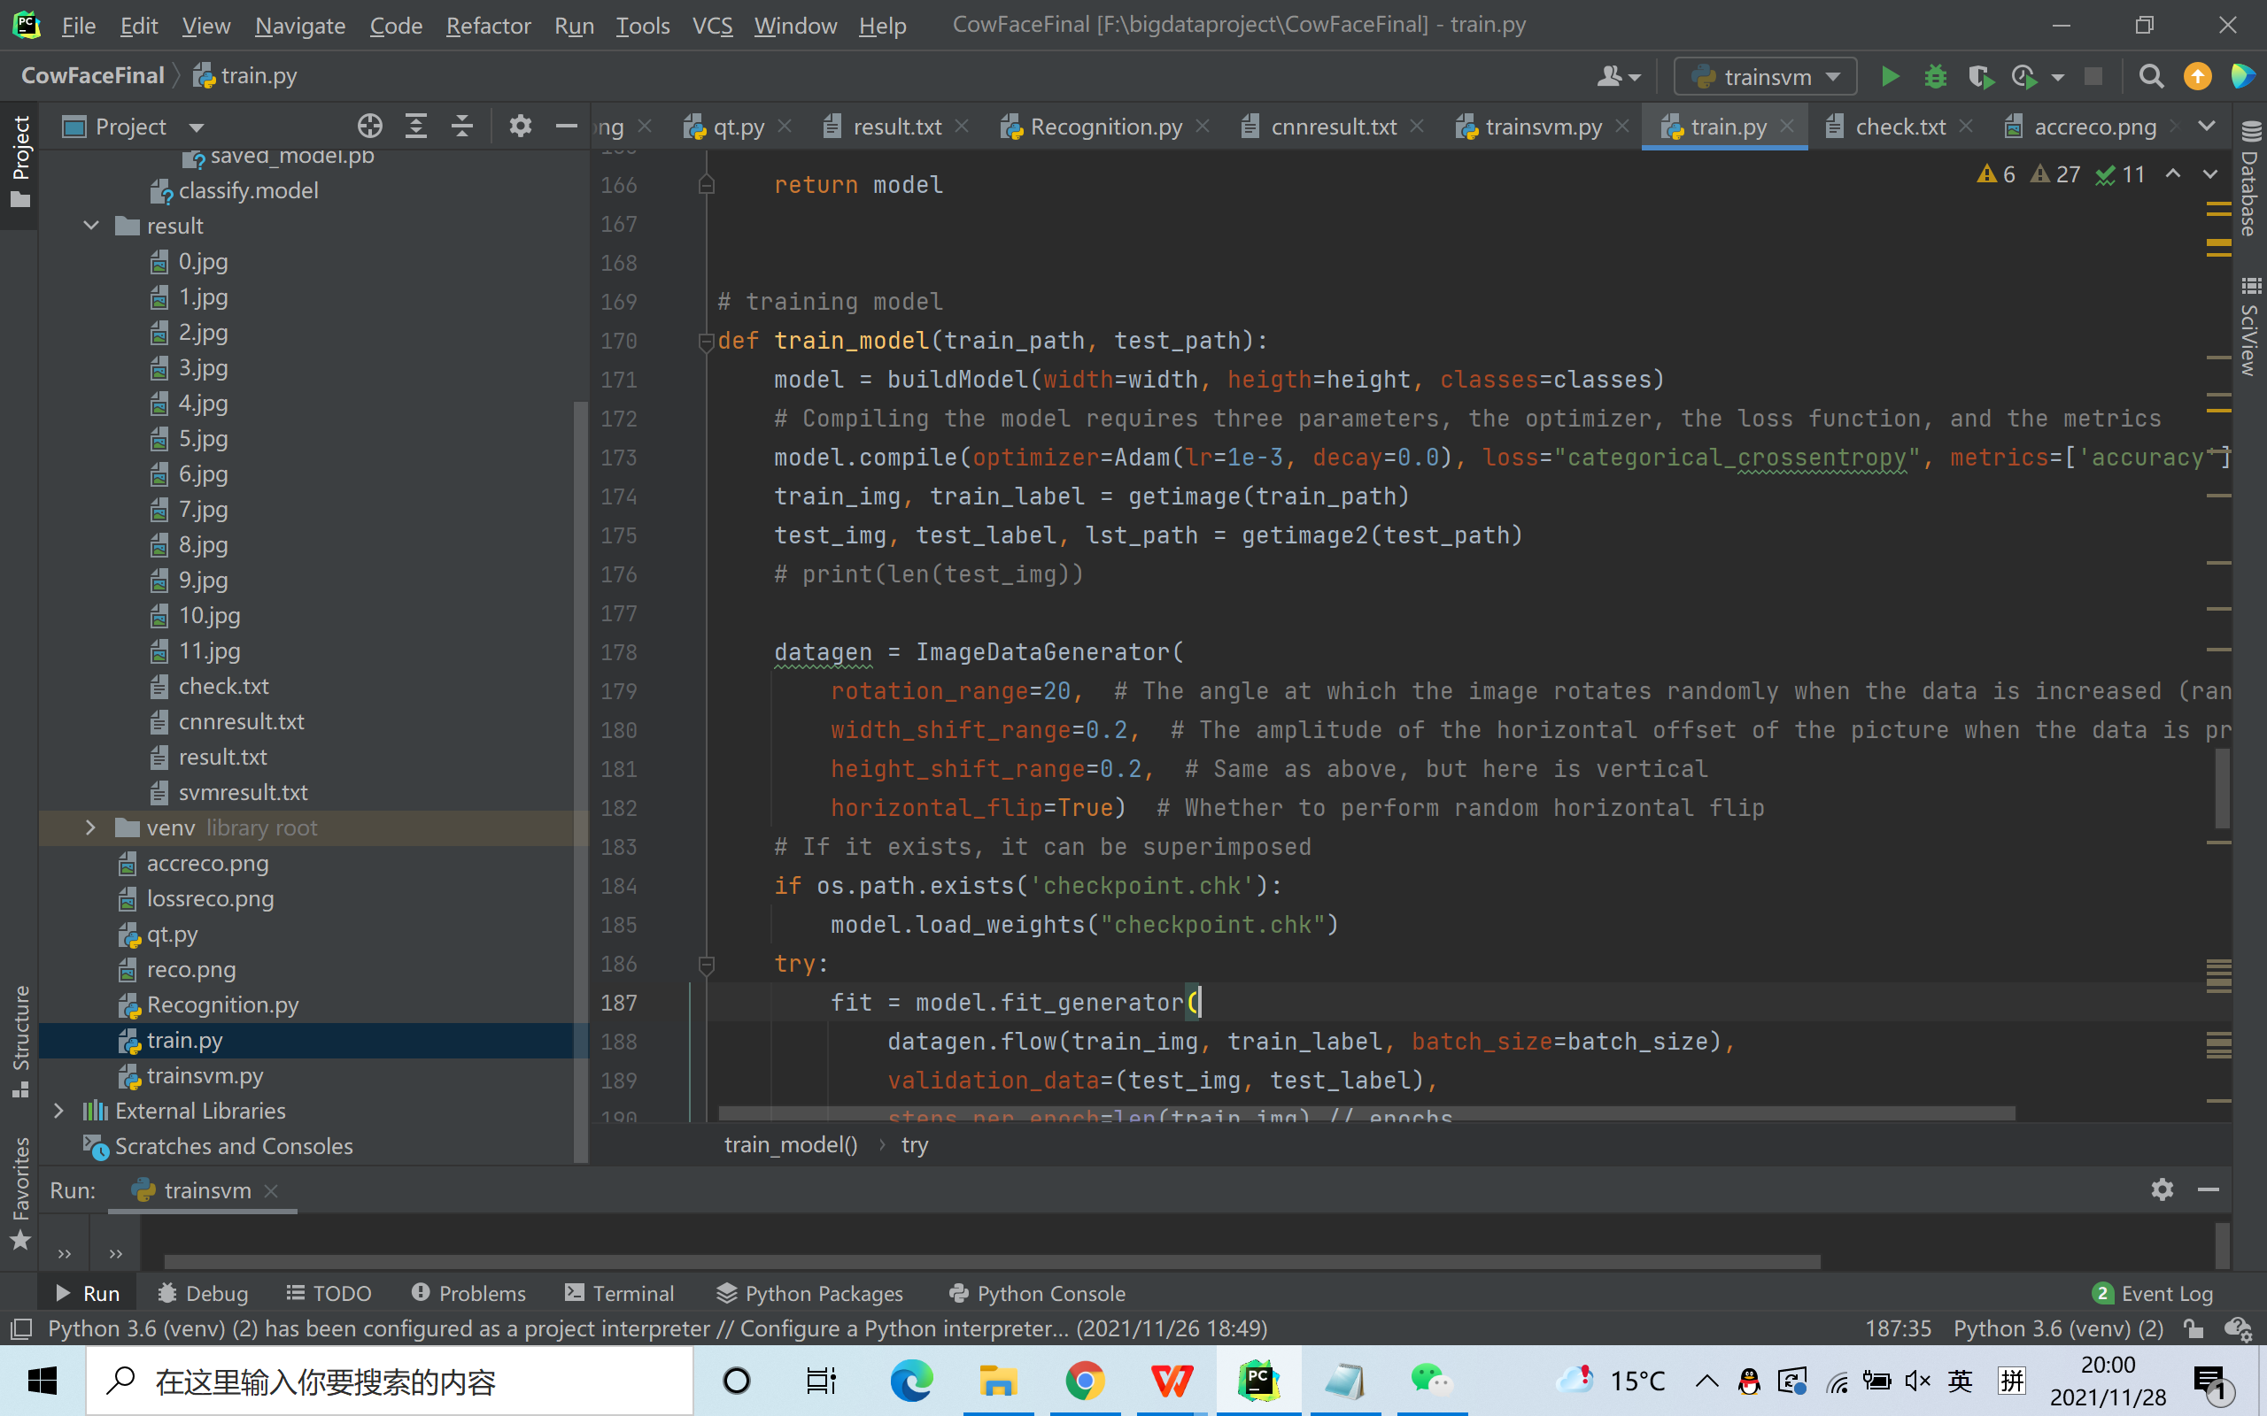
Model

Slide 11
03
PART
Visualization

Slide 12
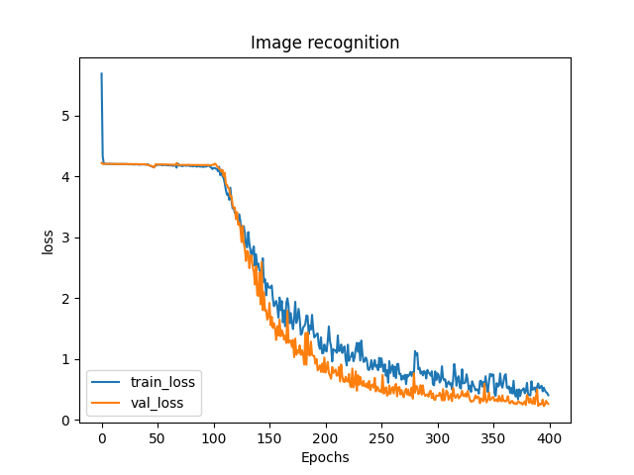
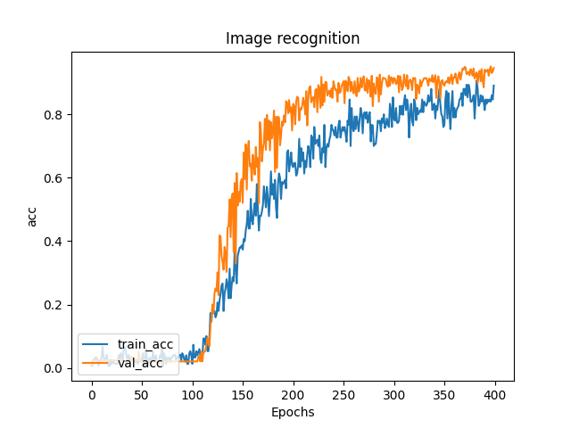
Visualization
This is the visualization of the outcome
Loss
Accuracy

Slide 13
04
PART
Application

Slide 14
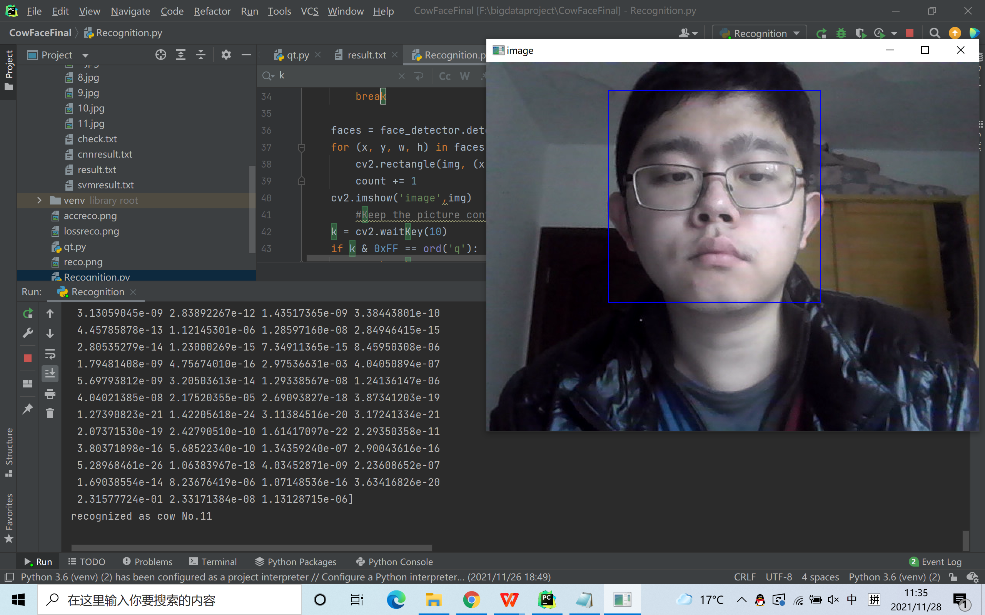
Recognization with face detection
文字替换
文字替换

Slide 15
05
PART
some other work

Slide 16
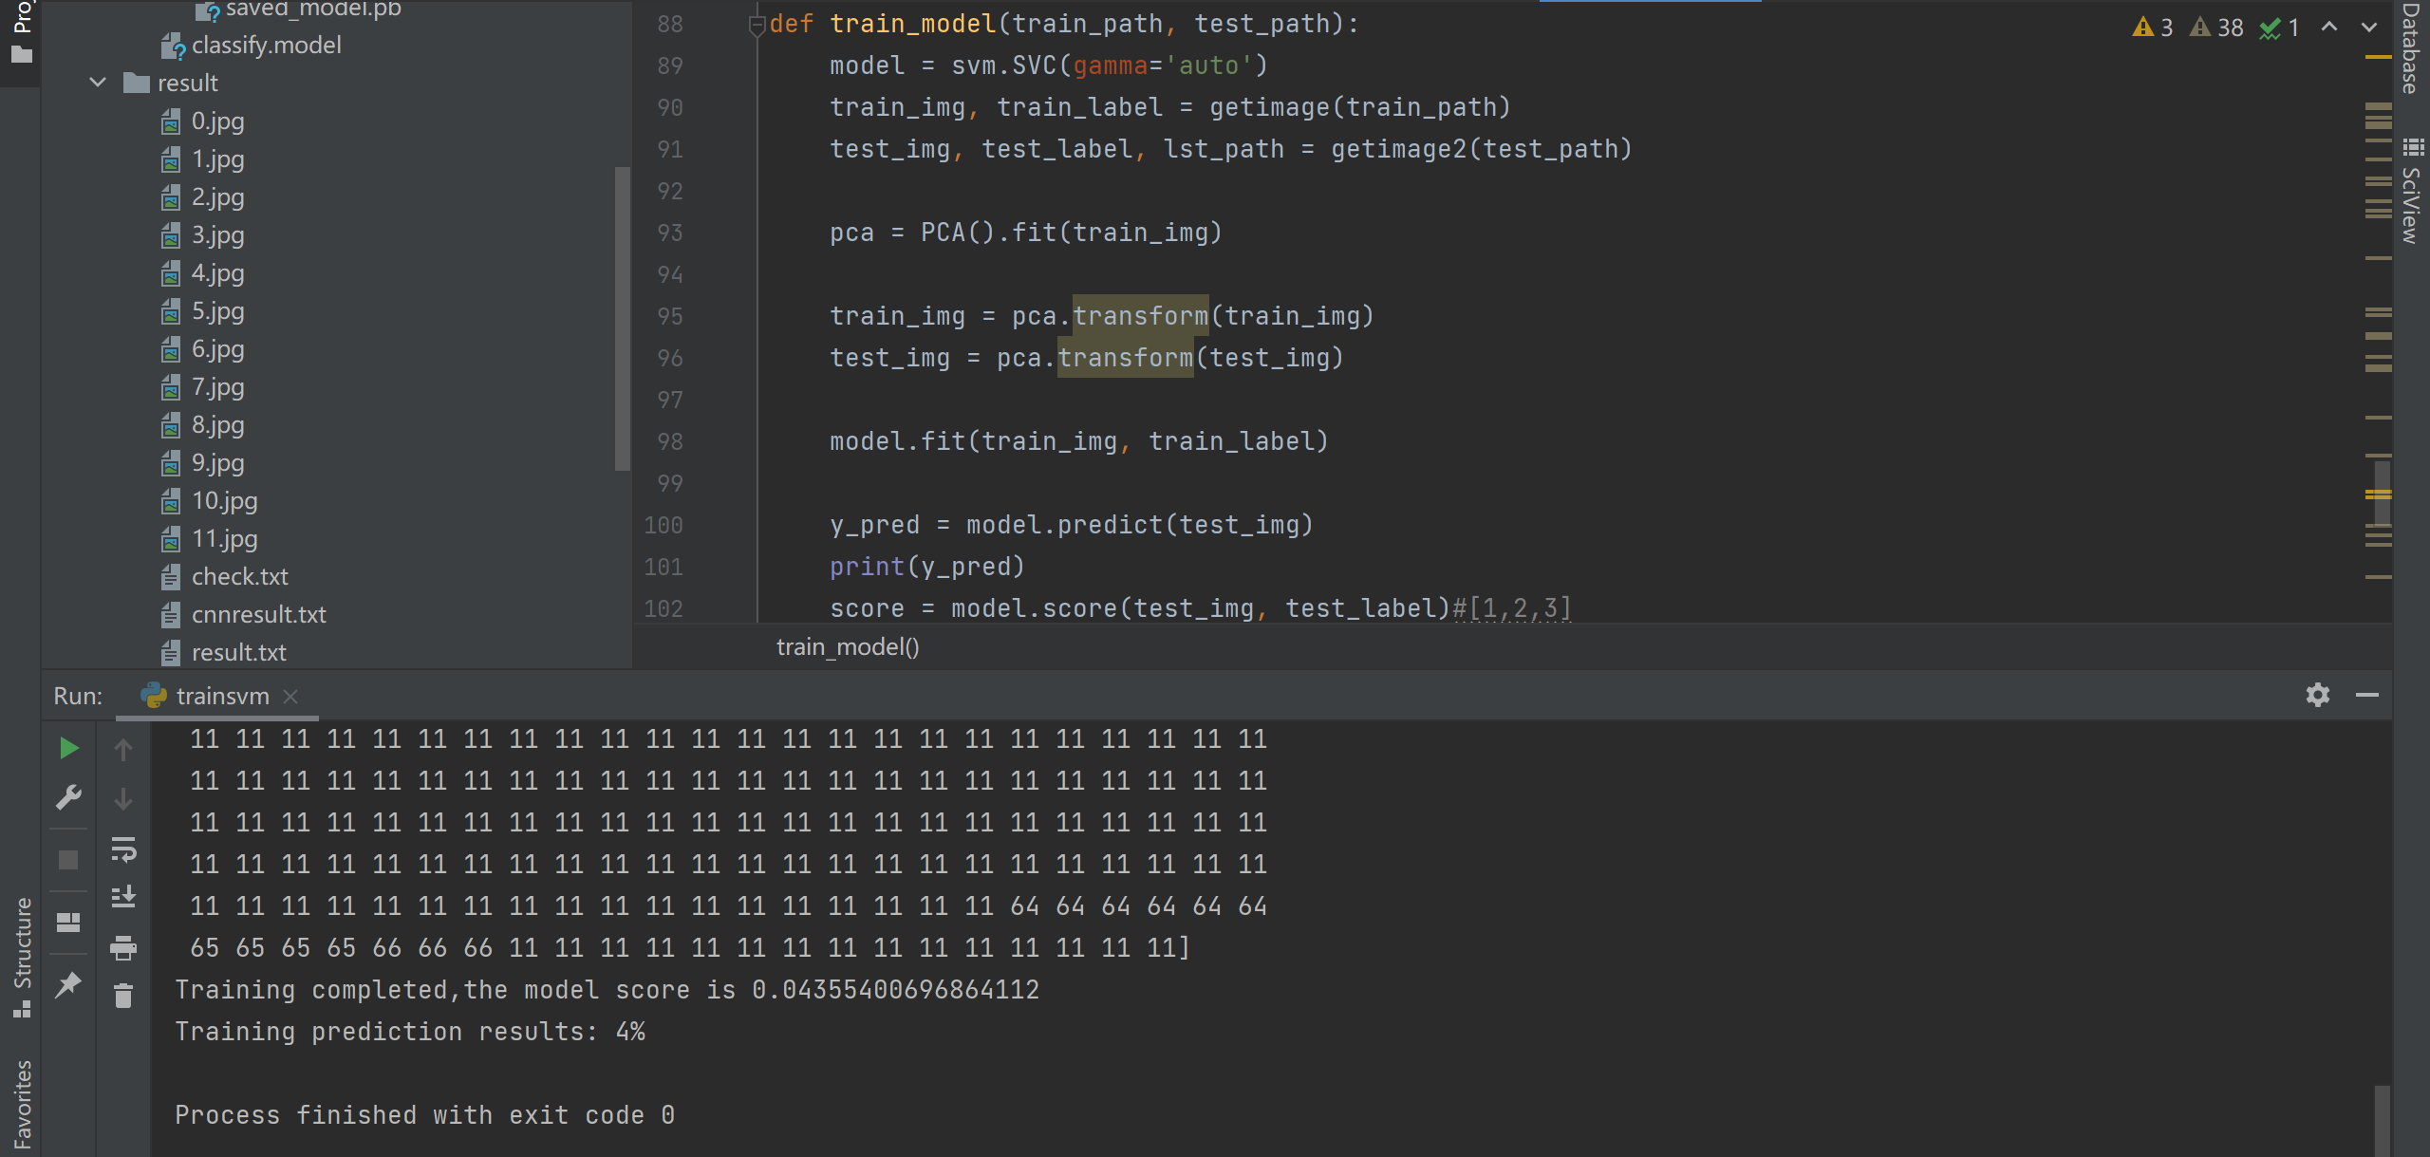
SVM
文字替换
文字替换

Slide 17
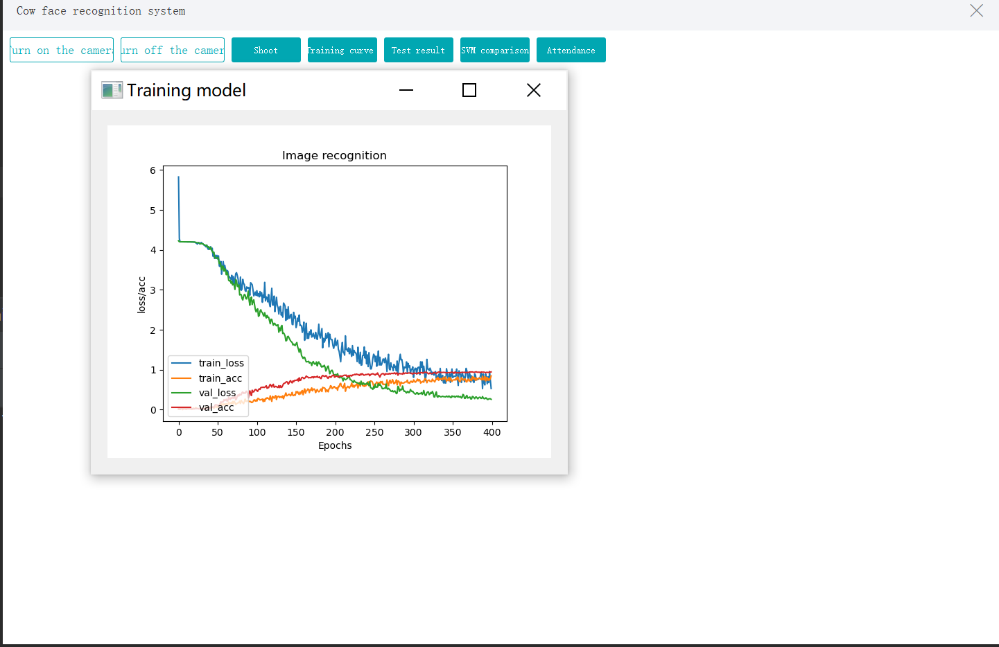
GUI
文字替换
文字替换

Slide 18
06
PART
prospect

Slide 19
01
02
03
04
mobile application
more data
more accurate
more practical

Slide 20
Thanks for watching
Group 19: Kent Xu
Huanwei Zhang

